Slide 1
Lesson 13
Object-oriented programming
Python Hybrid - Spring 2025

Slide 2
OOP: Introduction

Slide 3
Objects
Python supports many different kinds of data 1234 3.14159 "Hello" [1, 5, 7, 11, 13] {"CA": "California", "MA": "Massachusetts"}
Each is an object, and every object has:
a type
an internal data representation (primitive or composite)
a set of procedures for interaction with the object
An object is an instance of a type
1234 is an instance of an int
"hello" is an instance of a string c

Slide 4
EVERYTHING IN PYTHON IS AN OBJECT
(and has a type)

Slide 5
Objects
objects are a data abstraction that captures…
(1) an internal representation
• through data attributes
(2) an interface for interacting with object
• through methods (aka procedures/functions)
• defines behaviors and hides implementation

Slide 6
Why Object-oriented Programming ?
Breaks the programming task into objects, which combine data (known as attributes) and behaviors/functions (known as methods)
Used to structure a software program into simple, reusable pieces of code blueprints.
This makes OOP popular among larger development teams, that require easy ways to divide the workload.
There are two main components of the OOP: class and object

Slide 7
Building Blocks
* Classes
* Objects (instance of Class)
* Attributes (variables, properties)
* Methods (procedures, function)

Slide 8
Class
class Dog:
name = "Marley"
age = 5
breed = "Golden Retriever"
Class defines a new data type with attributes and methods.
Notes:
Can you have more than one class in a file?
here it’s a shared variable

Slide 9
Object/Instance
class Dog:
name = "Marley"
age = 5
breed = "Golden Retriever"
marley = Dog()
Instance / Object
Object is an instance of a class, i.e. a variable of the type defined by the class.
Notes:
Can multiple objects be created from the same class?

Slide 10
Variables (Attributes or Properties)
Attributes “hold data”. When modeling your classes think of them as “properties”.
* In OOP jargon they’re also known as variables or properties.
When working with classes, we use the following types of variables:
* Class Variables
* Instance Variables

Slide 11
Attributes
class Dog:
name = "Marley"
age = 5
breed = "Golden Retriever"
Class Attributes
Attribute is a data field inside the class.

Slide 12
Instance and self
class Dog:
def __init__(self, name, age, breed):
self.name = name
self.age = age
self.breed = breed
marley = Dog("Marley", 5, "Golden Retriever")
benny = Dog("Benny", 2, ”Corgi")
Constructor is defined by the __init__() function + Instance Attributes
Instance / Object
The two use cases of self
Notice that we use the self keyword to specify methods by setting the first parameter to self.
self is also used to refer to attributes and methods owned by the object instance.
Notes:
variable inside __init__ specific to object

Slide 13
Methods
class Dog:
def __init__(self, name, age, breed):
self.name = name
self.age = age
self.breed = breed
def bark(self):
print("wuff-wuff")
benny = Dog("Benny", 2, "Pug")
benny.bark() # prints "wuff-wuff"
method
Method is a function of the class, that can operate on the attributes, changing their values or returning new data depending on them.

Slide 14
Methods
class Dog:
def __init__(self, name, age, breed):
self.name = name
self.age = age
self.breed = breed
def bark(self):
print("wuff-wuff")
def __str__(self):
return f"{self.name}, {self.age} years old, {self.breed}"
benny = Dog("Benny", 2, "Pug")
benny.bark() # prints "wuff-wuff"
print(benny) # prints "Benny, 2 years old, Pug"
method
__str__ method

Slide 15
Data Access and Method Calling
To access instance and class variables (attributes), use the dot notation:
instance_name.attribute
ClassName.attribute
To “run” or execute a method, just call it as a normal function:
instance_name.method()
instance_name.method(arg1, kwarg1=value)
Try it yourself. Create a simple class in an interactive Python session and access its attributes using the above notation.

Slide 16

Creating our own class
Data attributes:
name
age
Methods:
getName()
canVote()
isRetired()
rename(name)
Class name: Human

Slide 17

Instances of Human
Maria Dima Oksana John
10 12 11 13

Slide 18
Let’s implement our first class!
Attributes:
name
age
Methods:
getName()
canVote()
isRetired()
rename()
Class name: Human

Slide 19
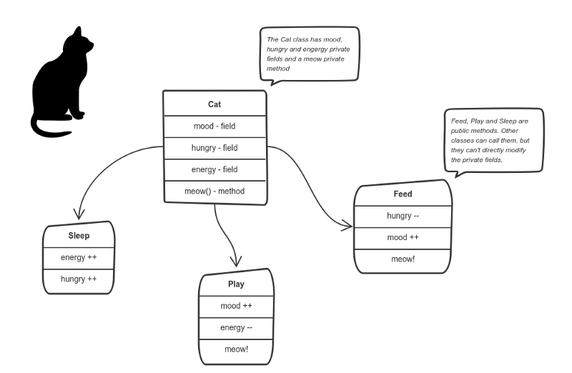

Slide 20
THINK ABOUT YOUR CLASSES Write them down

Slide 21
isinstance(instance, class_name)
class Dog:
def __init__(self, name, age, breed):
self.name = name
self.age = age
self.breed = breed
def bark(self):
print("wuff-wuff")
def __str__(self):
return f"{self.name}, {self.age} years old, {self.breed}"
benny = Dog("Benny", 2, "Pug")
if isinstance(benny, Dog): print("Benny is a dog.")
else:
print("Benny is NOT a dog.")

Slide 22
Class Variables
Will be available for all class instances (objects).
Be careful when using them. They have the similar pitfalls as global variables. Avoid mutable types.
Use them to share “state” among all the class instances.
Important: They must be defined outside the class methods.
class Shark:
species = 'fish' # class variable
def __init__(self, weight):
self.weight = weight # instance variable

Slide 23
Class Variables
class Dog:
tricks = [] # mistaken use of a class variable
def __init__(self, name):
self.name = name
def add_trick(self, trick):
self.tricks.append(trick)
When using this class in an interactive session, you will get the following output:
>>> d = Dog('Fido')
>>> e = Dog('Buddy')
>>> d.add_trick('roll over')
>>> e.add_trick('play dead')
>>> d.tricks # unexpectedly shared by all dogs
['roll over’]
Source: https://docs.python.org/3/tutorial/classes.html#class-and-instance-variables

Slide 24
Instance Variables
class Dog:
def __init__(self, name):
self.name = name
self.tricks = [] # creates a new empty list for each dog
def add_trick(self, trick):
self.tricks.append(trick)
Defined in the __init__ method.
Belongs exclusively to an object (instance).
Cannot be modified by other instances.

Slide 25
Encapsulation
Should user have
access to them?
Attributes:
name
age
Methods:
getName()
canVote()
isRetired()
rename()
Class name: Human

Slide 26
Protected / Private Variables
class Foo:
def __init__(self):
self._count = 0
pass
def say_hello(self):
self._count += 1
print('Hello World')
def get_count(self):
return self._count
“Private” instance variables that cannot be accessed except from inside an object don’t exist in Python.
However, there is a convention that is followed by most Python code: a name prefixed with an underscore (e.g. _spam)

Slide 27
Protected / Private Variables
class Foo:
__count = 0
def __init__(self):
pass
def say_hello(self):
self.__count += 1
print('Hello World')
def get_count(self):
return self.__count
The use of double underscores is known as “name mangling” and it’s intended to provide an easy way to create private variables or methods in Python.

Slide 28
Style Conventions for OOP
Python recommends several conventions for working with OOP constructs:
Class names should be written in CapWords.
Use lowercase with words separated by underscores for method names and instance variables.
Private methods or variables should be prefixed with an underscore.
For more information, take a look at PEP8:
https://pep8.org/

Slide 29
Programming Paradigms
Fundamental style or approach to programming that provides a framework for building and designing programs
It encompasses a set of principles, concepts, and techniques used to structure, organize, and express code
Different programming paradigms offer distinct ways of thinking about and solving problems in programming

Slide 30
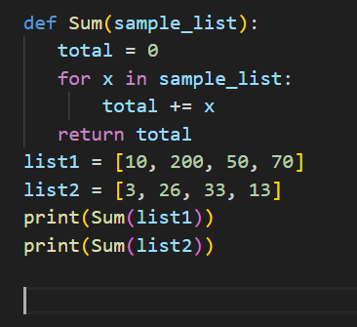
The Three Major Paradigms
Procedural Programming
Series of computational steps, these steps instruct the computer on how to solve a task in logical steps

Slide 31
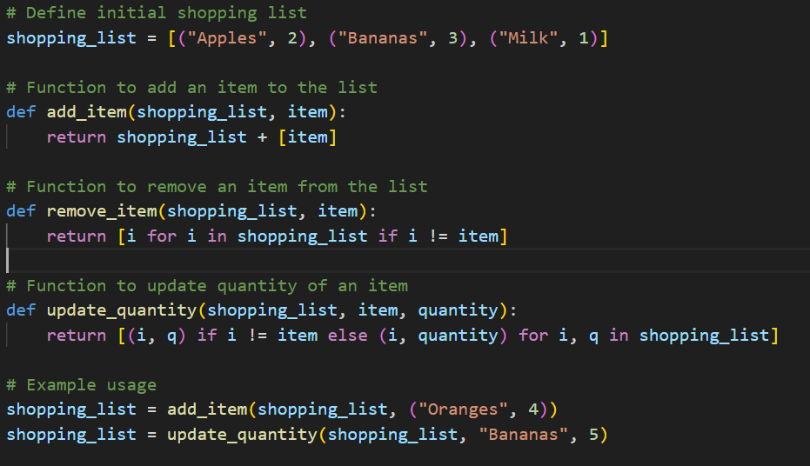
The Three Major Paradigms
Functional Programming
Use pure functions for manipulating data

Slide 32
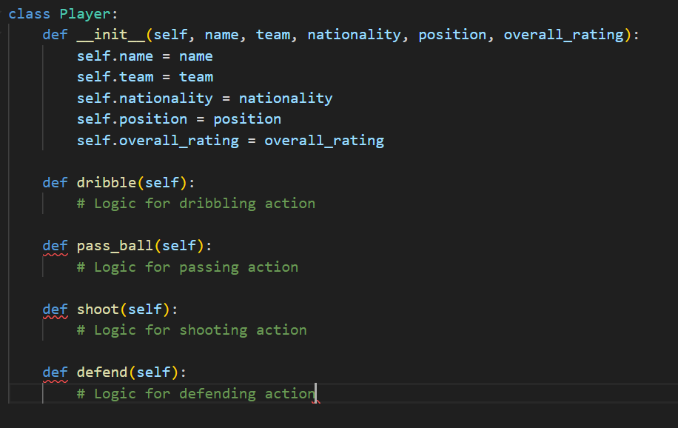
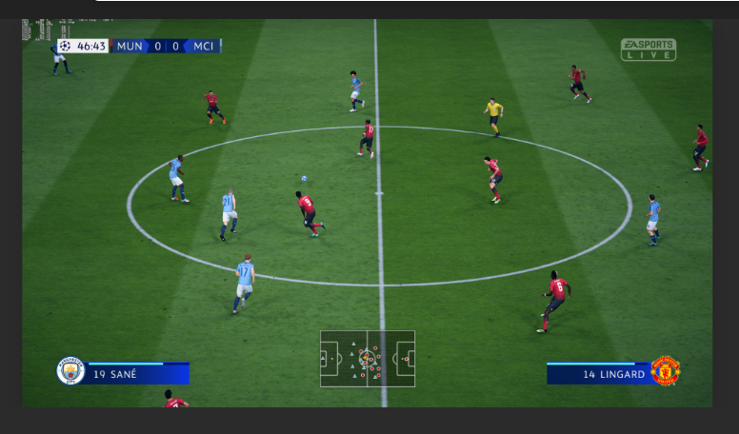
The Three Major Paradigms
Object Oriented Programming
Model real-world entities as objects, which have attributes (characteristics) and methods (actions or behaviors)

Slide 33
Object Oriented Programming
Main Benefits
Modularity & Reusability
breaking down complex systems into smaller, more manageable objects
reused in different parts of a program or in different programs altogether
Abstraction & Encapsulation
Objects have simplified, essential characteristics. This focuses on what an object does rather than how it does it, managing complexity and enabling high-level design
Hides the internal state of objects and restricts access to their data
Inheritance and Polymorphism
Inherit attributes and methods from parent classes, promote code reuse and establishing hierarchical relationships between classes
Objects of different classes to be treated as objects of a common superclass. Behavior varying based on specific types or contexts

Slide 34
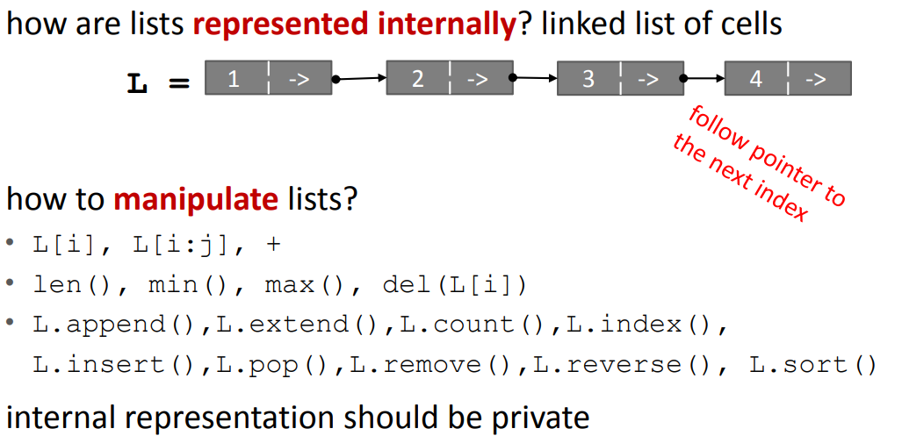

Slide 35

Exercises

Slide 36
Encapsulation
Attributes:
name
dateOfBirth
dateOfNameChange
countryOfOrigin
profession
Methods:
getName()
canVote()
isRetired()
rename()
Class name: Human

Slide 37
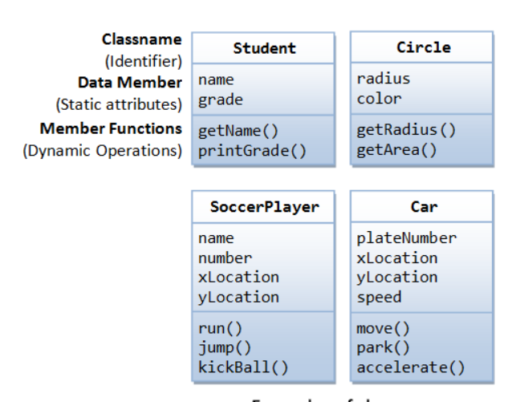
Implement
these classes

Slide 38
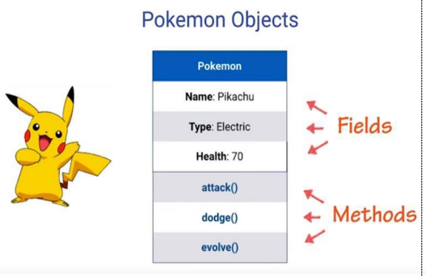

Slide 39
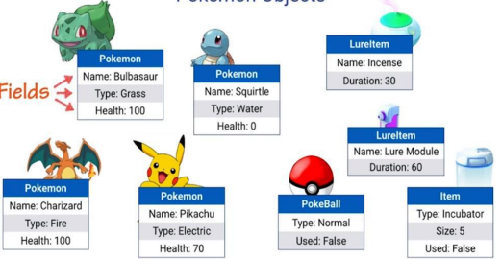

Slide 40
Exercise
Write a BankAccount class that works like specified:
Steps:
Store the current value of the BankAccount in an attribute named balance that should start with 0. (Hint: implement __init__() function)
Now create some instances of BankAccount and check whether they are instances of the said classes or not (Hint: use isinstance() for this)
Add a deposit method that receives a value and adds it to balance and prints balance
Add a withdraw method that receives a value and subtracts it from balance and prints balance

Slide 41

Exercise
We want to make our BankAccount class a bit more robust against unintended behavior. Make the necessary changes to accommodate the following behavior:
We only want users to be able to deposit and withdraw a positive amount. A ValueError should be raised. e.g.: bank_account.deposit(-200) -> ValueError
A ValueError should be raised if the user inputs anything that can’t be interpreted as an integer. e.g.: bank_account.deposit(“Not an integer”) -> ValueError

Slide 42
Complete the following exercises
Easy
https://www.codewars.com/kata/513f887e484edf3eb3000001/train/python
https://www.codewars.com/kata/55a144eff5124e546400005a/train/python
Change just one word, but it’s tricky ;o)
https://www.codewars.com/kata/55cd4ce59382498cbd000080/train/python
More complex
https://www.codewars.com/kata/5a03af9606d5b65ff7000009/train/python
https://www.codewars.com/kata/5981ff1daf72e8747d000091/train/python
https://www.codewars.com/kata/572bbd7c72a38bd878000a73/train/python
Search for more exercises: https://www.codewars.com/kata/search/python?q=class&r%5B%5D=-6&r%5B%5D=-7&r%5B%5D=-8&beta=false&order_by=popularity%20desc

Slide 43
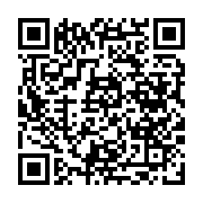
Before you go…
Please take 2 minutes to give us feedback on today’s lesson.
This feedback is anonymous and only seen by the DCP team!
Scan the QR code or go to: https://redischool.typeform.com/lessonfeedback

Slide 44
Thank you for your attention!
See you next class!

